Slide 1
Total Solution Vendors
Business Intelligence
Erwin Moeyaert

Slide 2






SQL Server 2005
A Complete Enterprise Data Management and BI Solution
Development Tools
Reporting Services
Management Tools
Analysis Services
OLAP & Data Mining
Data Transformation
Services
ETL
SQL Server
Relational Engine

Slide 3
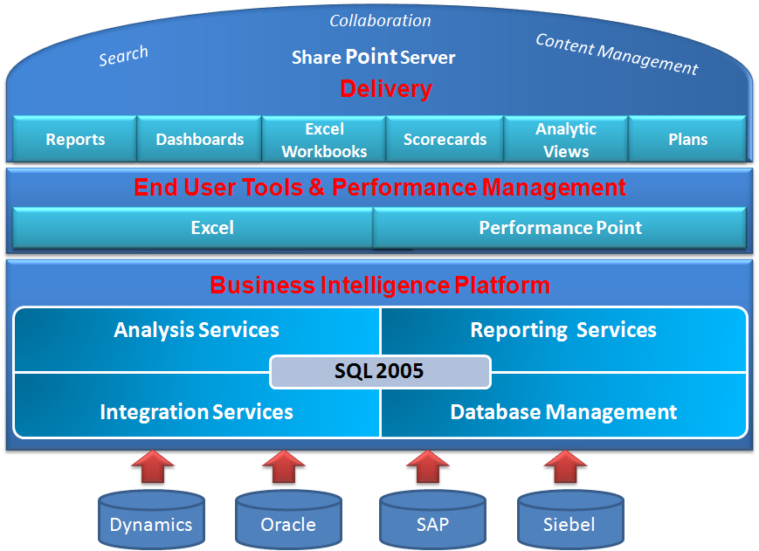
Microsoft BI Platform

Slide 4
Microsoft BI Platform

Slide 5

SQL Server Database Management
SQL Server Relational Database – provides a robust, scalable and enterprise-ready Data Warehouse platform. Microsoft SQL Server 2005 has improved partitioning, manageability, and query optimizations to streamline data warehouse operations and increase performance.
Many Business Solutions and systems currently use this database.
Business Intelligence Platform
SQL 2005
Analysis Services
Reporting Services
Integration Services
Database Management

Slide 6
SQL Server Analysis Services
Allows for Online Analytical Processing (OLAP), commonly referred to as “cubes”.
Includes advanced analytical features such as complete data mining and key performance indicator frameworks.
Enables organizations to accommodate multiple analytic needs within one solution.
Business Intelligence Platform
SQL 2005
Analysis Services
Reporting Services
Integration Services
Database Management

Slide 7
SQL Server Reporting Services
Provides a complete reporting platform so that end-users can view data using a Web browser or desk top.
Includes report authoring tools for both technical developers and business users.
Allows web-based viewing and rendering in popular document formats such as Microsoft Excel and PDF.
Contains robust e-mail subscription capability.
Business Intelligence Platform
SQL 2005
Analysis Services
Reporting Services
Integration Services
Database Management

Slide 8
Microsoft BI Platform

Slide 9
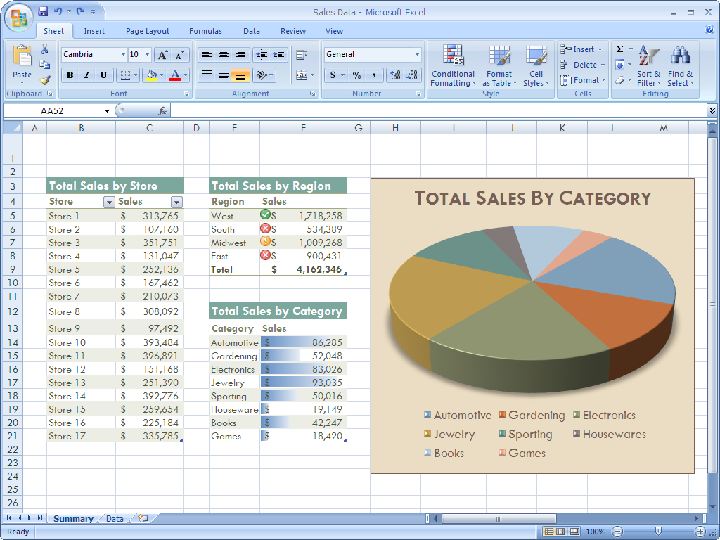
Microsoft Excel 2007
End User Tools & Performance Management
Excel
Performance Point

Slide 10
Office PerformancePoint Server 2007
Planning
  Drive strategic objectives and goals into the planning and budgeting process to ensure departmental plans align with corporate strategy.
Monitoring and Analysis
  Powerful analytics capabilities empower business users to access data and to perform analyses on their own so that they can make better, faster decisions.
Release scheduled for Q4, 2007
End User Tools & Performance Management
Excel
Performance Point

Slide 11
Microsoft BI Platform

Slide 12
Microsoft Office SharePoint Server
Key Benefit: makes information easy to access and use.
Brings the “Self-Service” to BI.
Serves as the central access point for all reports and business data.
Provides integration to Reporting Services, Microsoft Excel, ProClarity Analytics, Dashboards (currently known as Business Scorecard Manager) and PerformancePoint Server.
Allows users to collaborate, annotate and search.
Stores documents in a document library.
Collaboration
Content Management
Share Point Server
Search
Delivery
Reports
Dashboards
Excel Workbooks
Scorecards
Analytic
Views
Plans

Slide 13
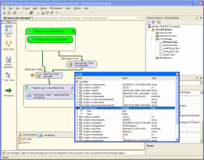
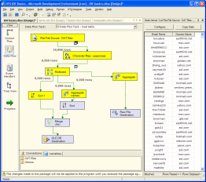
Data Transformation Services
Breakthrough ETL capabilities
Enterprise ETL platform
  High performance
  High scale
  Trustworthy and reliable
Best in class usability
  Rich development environment
  Source control
  Visual debugging of control flow and data
  Great range of transforms out-of-the-box
Highly extensible
  Custom tasks
  Custom enumerations
  Custom transformations
  Custom data sources
Notes:
Enterprise ETL platform
High performance – competitive with the best in the industry
High scale – distribute transformations across processors
Trustworthy and reliable – built-in data cleansing, error data handling and restartability
Best in class usability
Full developer IDE
Source control
Visual debugging of control flow and data
Configuration and deployment for develop, test and release.
Great range of transforms out-of-the-box: little or no scripting required!
Highly extensible – with native or managed code
Custom tasks
Custom enumerations
Custom transformations
Custom data sources

Slide 14
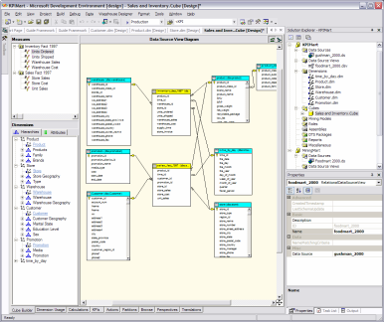
BI Development Studio
A complete, integrated tool for the development of BI applications
One tool, multiple technologies:
  Relational, OLAP, DM, DTS, Reporting, Code, Web pages…
Enterprise software development environment:
  Integrated into Visual Studio.NET
  Team development, source control, versioning, developer isolation, resource independent coding
Development cycle lifetime support
  Develop, Test, Deploy, Modify, Test…
Breakthrough ease of use

Slide 15
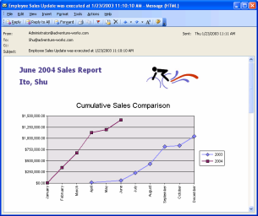
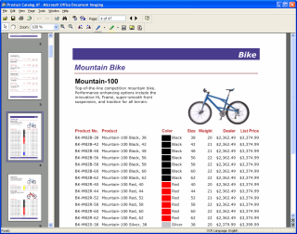
Reporting Services
  Open, extensible enterprise reporting solution
  Report authoring, management, delivery
  Office System integration
  VS.NET development environment
  Integration with AS, DTS, management tools
  Developer enhancements
  Improved report interactivity
  Rich end-user reporting

Slide 16
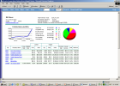





Reporting Services Architecture
Browser
Office
Custom App
Report Control
Report Processing
Rendering
Data Proc.
Web UI
Data Sources
(SQL, OLE DB, XML/A,
ODBC, Oracle, Custom)
Security Services
(NT, Passport,
Custom)
XML Web Service Interface
Report Server
Report Processing
Data Processing
Security
Rendering
Scheduling and
Delivery
Output Formats
(HTML, Excel,
PDF, Custom)
Delivery Targets
(E-mail, SharePoint,
Custom)
SQL Server Catalog

Slide 17
Analysis Services
Unified Dimensional Model
  Integrating relational and OLAP views
Pro-active caching
  Bringing the best of MOLAP to ROLAP
Advanced Business Intelligence
  KPIs, MDX scripts, translations, currency…
Web services
  Native XML/A

Slide 18
Data Mining Focus
Complete set of analytics
  Most popular data mining algorithms (5 new)
  Enhanced creating, editing, and viewing environment
Embedded data mining
  Embed data mining in LOB applications
  Complete SQL language based API
  Native XML/A support
Integrated solution
  Tight integration with Relational, OLAP, DTS, Reporting technologies
  Comprehensive SQL Server BI platform
Alliance with ISVs
  Focus on broadening the market
  Agreed on finalizing DM industry standard based on OLE DB for DM and XML/A
Notes:
Microsoft's goal for the data mining functionality in SQL Server 2005 is to build tools that:
Are easy to use
Provide a complete set of features
Are easily embedded in production applications
Integrate closely with the other SQL Server BI technologies, and
Extend the market for data mining applications.
To date, the development of such applications has been focused on the biggest problems at the biggest companies – those who can afford scarce analytical talent and high development costs that have traditionally been required to build a data mining application. Just as Microsoft's OLAP technologies have helped the OLAP market to grow, we are looking to extend data mining technologies to enterprises and corporate departments that have not been able to develop such applications in the past.
Use the SQL Server 2005 Data Mining tools to explore a set of data for patterns, and then optionally perform prediction on those patterns. That's all data mining is: exploration, pattern discovery, and pattern prediction.

Slide 19
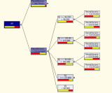
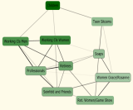
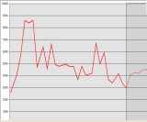
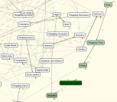
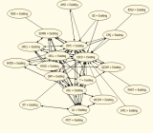
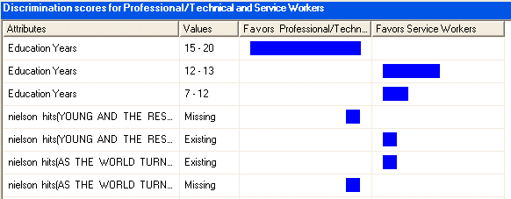
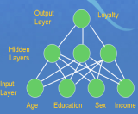
Complete Set of Algorithms
Decision Trees
Clustering
Time Series
Introduced in SQL Server 2000
Sequence Clustering
Association
Naïve Bayes
Neural Net
Notes:
All data mining tools, including Microsoft SQL Server 2005 Analysis Services, use multiple algorithms. Analysis Services, of course, is extensible; third party ISVs can develop algorithms that snap in seamlessly to the Analysis Services data mining framework. Depending on the data and the goals, different algorithms are preferred, and each algorithm can be used for multiple problems.
Analytical problem Examples Microsoft algorithms
Classification: Assign cases to predefined Decision Trees Naďve Bayes
Nueral Nets
classes such as "Good" vs "Bad“
Credit risk analysis
Churn analysis
Customer retention

Slide 20
Oracle Intelligence
Overview

Slide 21
Oracle Solutions Business Intelligence
Provide Tools and Applications that are:
  Complete
  Integrated
  Scaleable
  High Availability
  Secure
  Standards based
Notes:
E-Business Intelligence enables:
- Effective use of the Internet for business
- Compression of the decision cycle
- Decisions at the point of impact
- Automation of key decision processes
- Business leverage of massive data volumes
- Faster time to benefit

Slide 22
Data Warehousing and
Organizational Intelligence
Cobol or
NATURAL
Application
?
Oracle9i
Ad Hoc Query
Data Warehousing
Treehouse
Software
ETL
OLAP
OLAP
Data Mining
ADABAS
RDBMS
Data Mining
Transactional Data
& Applications
Data Warehouse
Intelligence

Slide 23
Oracle9i Business Intelligence Platform
Oracle9i
Data Warehousing
ETL
OLAP
Data Mining
Single business intelligence platform
  Reduce administration and implementation costs
  Faster deployment
  Improved scalability and reliability
Notes:
Oracle9i is the platform for all business intelligence applications.
By integrating relational data-warehouse capabilities with ETL, OLAP, and data-mining functionality into a single server platform, Oracle9i provides tremendous benefits:
- reduced administration costs: only one server-product, administered using one management tools (Oracle Enterprise Manager). Leverage existing Oracle RDBMS administration expertise for all aspects of business intelligence.
- faster deployment: new applications can be deployed much faster, since there is no longer any need to manually integrate multiple products.
- improved scalability, reliability, security: Core benefits of the relational database are now extended to the entire BI platform. With Oracle9i, areas such as OLAP and data-mining can now achieve mission-critical availability. A single platform centralizes the management of data-security, so that access policies are consistent regardless of the application.
Other benefits:
- integrated release process: the components of the BI platform are integrated, so that the entire platform is upgraded together rather than upgrading individual components. This ensure interoperability of all components at all times.
- enhanced data synchronization: the data stored in multiple server products does not need to be ‘synched’ manually. Having a single platform will enable new data to be quickly and easily incorporated into all aspects of the business intelligence system.

Slide 24
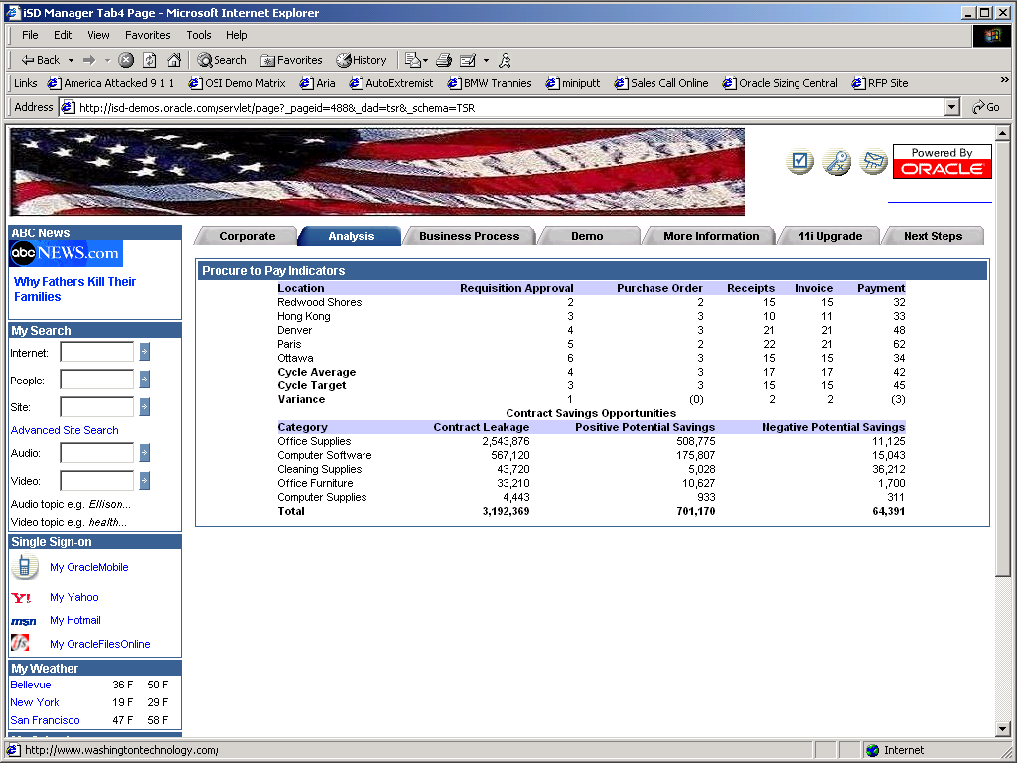

Slide 25
Platform for Business Intelligence: ETL
Data Warehousing
Warehouse Builder
  Extensible framework for designing and deploying DW’s
ETL
OLAP
Transformation Engine
  Integrated in Oracle9i
  Scalable (parallel)
  Extensible (Java, PL/SQL)
  Efficient (no data staging)
Data Mining
Oracle9i
Notes:
‘ETL’ stands for ‘extraction, transformation, loading’. This is the process of extracting data from source systems and loading data into the data warehouse.
Oracle9i includes Oracle Warehouse Builder. OWB provides an extensible framework and productive GUI for designing and deploying data warehouses and data marts. OWB is available today, and utilized Oracle8i for data-transformations.
Oracle9i introduces many new SQL features to improve the scalability and performance of ETL operations. These new features

Slide 26
Platform for BI: OLAP
OLAP Services
Analysis-ready Oracle database
  Support for complex, multidimensional queries
  Highly scalable
Development platform for Internet-ready analytical applications
  Java OLAP API
  Business Intelligence Beans and JDeveloper
Data Warehousing
ETL
OLAP
Data Mining
Oracle9i

Slide 27
Platform for Organizational Intelligence:
Data Mining
Data Warehousing
Oracle Personalization
  Real-time personalization engine for building 1:1 relationships over the web
ETL
OLAP
Data Mining Suite
  Scalable, integrated data-mining capabilities
Data Mining
Oracle9i

Slide 28
Platform for Organizational Intelligence:
Data Warehousing
Data Warehousing
Foundation of the Business Intelligence Platform
More data
More users
Faster
Simple management
Oracle9i introduces dozens of new DW features
ETL
OLAP
Data Mining
Oracle9i

Slide 29
Oracle Organizational Intelligence
Summary
Provide Organizational Intelligence
Technology and Applications
that are:
  Complete
  Integrated
  Scaleable
  High Availability
  Secure
  Standards based
Data Warehousing
ETL
OLAP
Data Mining
Oracle9i

